Slide 1
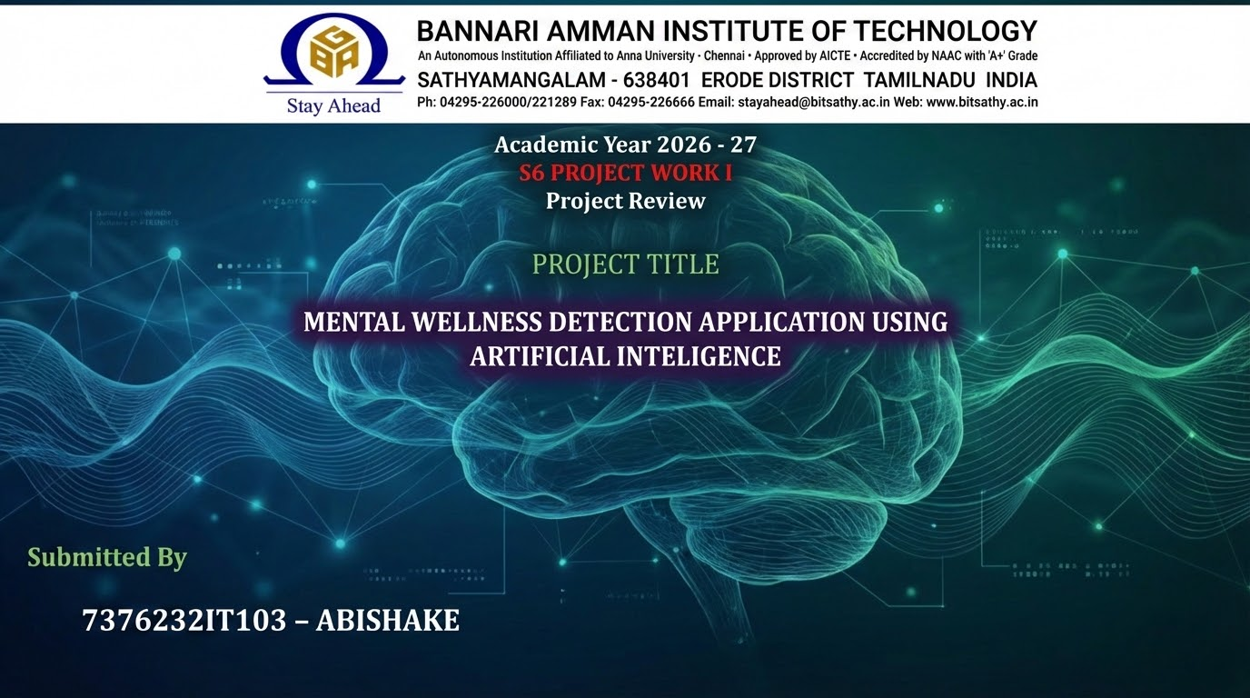

Slide 2
Problem Statement
PROBLEM STATEMENT
In the modern digital era, individuals frequently face stress and mental health challenges but often lack accessible, private, and real-time tools to monitor their psychological well-being. Existing solutions are often fragmented, require expensive subscriptions, or compromise user privacy by storing sensitive emotional data on external servers. Furthermore, many general-purpose health apps lack the specific integration of local Artificial Intelligence (AI) to provide immediate, context-aware feedback without relying on high-latency cloud APIs.

Slide 3
PROPOSED SOLUTION
This project aims to develop a Mental Wellness Detection Application—a secure, web-based platform that provides users with a centralized dashboard to track mental health metrics like mood, meditation progress, and personal wellness goals.
Key Objectives:
Privacy-First AI: Utilizing local Large Language Models (LLMs) like Tiny Llama via Ollama to ensure user data processed for sentiment and wellness detection never leaves the local environment.
Robust Security: Implementing strict session management and secure database authentication using PostgreSQL/Supabase to protect sensitive user profiles.
Scalable Architecture: Moving from a local-only H2 database to a cloud-integrated production environment on Render, ensuring the application is accessible anytime, anywhere.
User-Centric Design: Providing a personalized interface (JSP/Servlet based) that encourages consistent mental health tracking and goal setting.

Slide 4
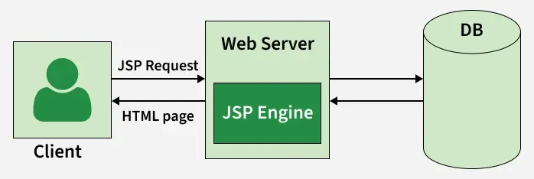
ARCHITECTURE OF PROJECT
JSP Application workflow
POSTGRE from
SUPABASE (BAAS platform)

Slide 5
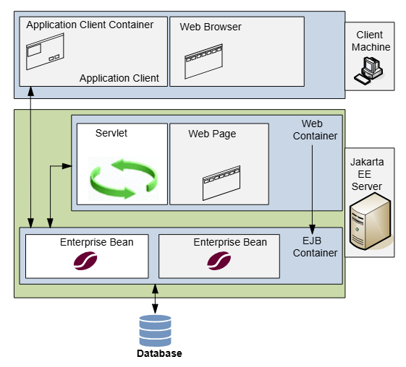
Jakarta EE Servlet

Slide 6
LITERATURE SURVEY
S.NO | PUBLICATION DESCRIPTION AND AUTHOR | REFERENCE LINK
1. | Goal Of Application and the features derived by references from WHO site | LINK
2. | AI-powered mental health application with data privacy preservation | LINK
3. | Large Language Models in Mental Health Care: A Scoping Review | LINK
4. | Comparison of the performance of relational databases PostgreSQL and MySQL for desktop application | LINK
5. | Dockerizing the application | LINK
NOTE:
THE SURVEY WAS CONDUCTED FROM CREDIBLE SOURCES AND RESEARCH REFERENCES

Slide 7


